Slide 1
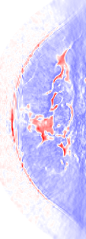
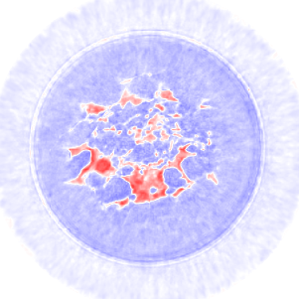
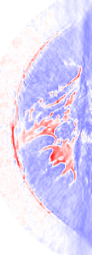
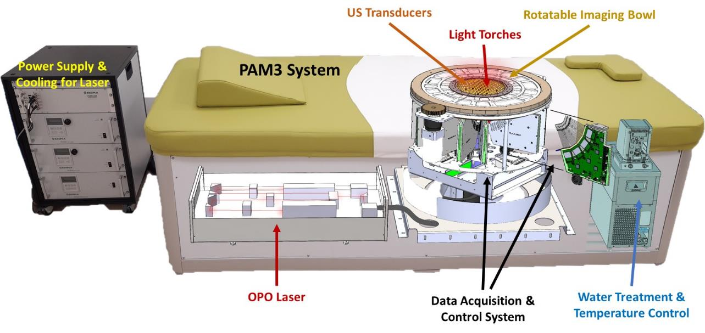
Photoacoustic and Ultrasonic Tomography for Breast Imaging
Felix Lucka (he/him, felix.lucka@cwi.nl)
Oberwolfach, 4th May 2023

Slide 2

EU+UK wide PhD training network: 8 beneficiaries and 4 associated partners from 8 European countries
!!! 11 PhD positions, deadline extended until May 15!!!
DC2: Photon transport modelling and image reconstruction algorithms for multispectral DOT with Tanja Tarvainen (UEF)
DC9: Adaptive compressed sensing using deep learning in non-linear microscopy with Felix Lucka (CWI)
DC11: Learned adaptive encoder-decoder architecture for advanced fluorescence imaging with Simon Arridge (UCL)
https://concise-project.eu/

Slide 3
Photoacoustic and Ultrasonic Tomography for Breast Imaging
Felix Lucka (he/him, felix.lucka@cwi.nl)
Oberwolfach, 4th May 2023

Slide 4

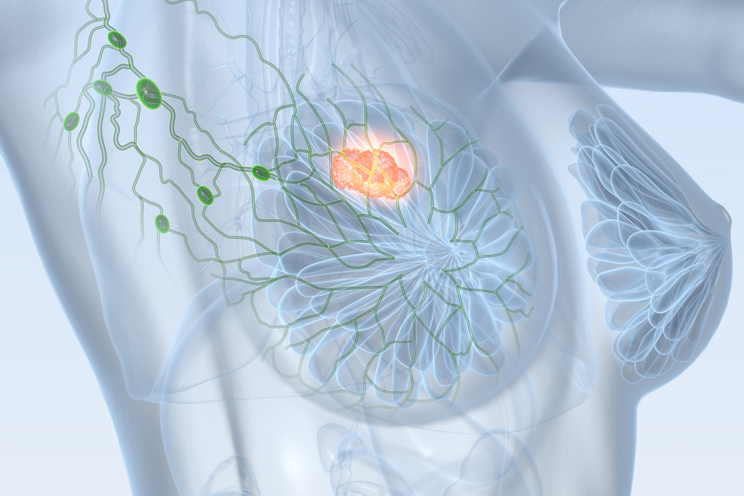
Breast Cancer
Most common cause of cancer death in women worldwide:
25% of all cancer cases
15% of all cancer deaths
Early detection and diagnosis are key to successful treatment!

Slide 5
Conventional Breast Imaging
Magnetic resonance imaging
contrast agent
expensive
availability
not suitable for every woman
Urgent need for novel imaging techniques providing higher specificity, contrast and image resolution than X-ray mammography at lower costs than MRI.
X-ray mammography
painful compression
ionizing radiation (tumor induction)
glandular tissue is problematic
Ultrasonography
whole breast imaging is difficult
operator dependent
courtesy of Rianne Bulthuis and Maura Dantuma

Slide 6
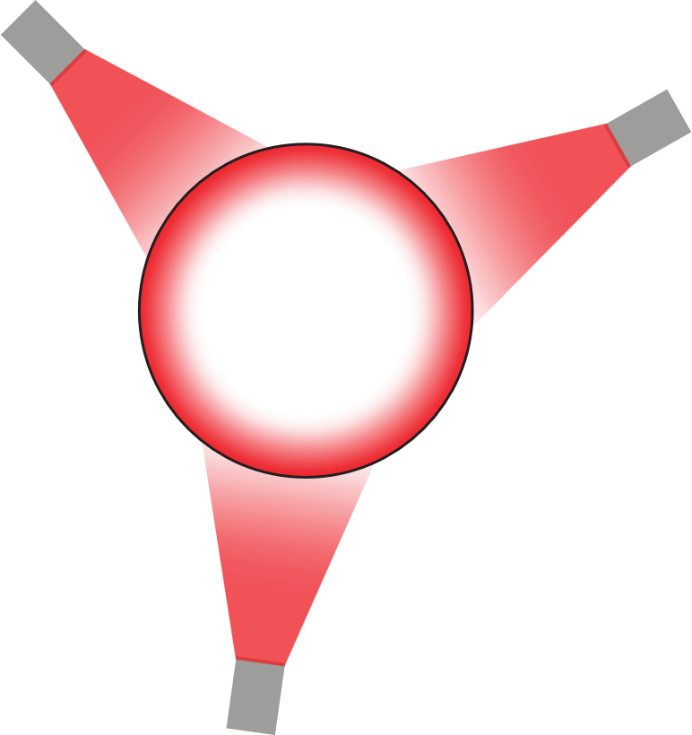
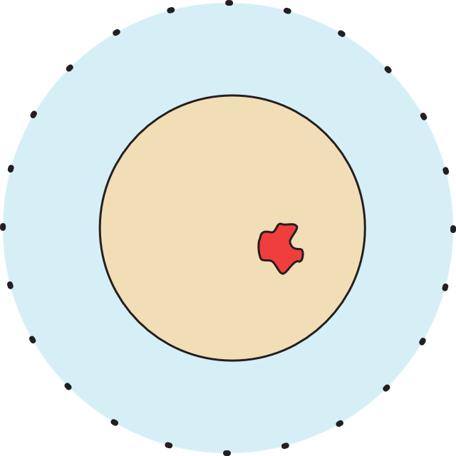





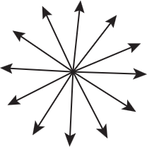

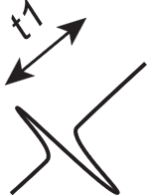
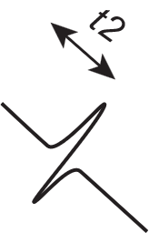
Photoacoustic Tomography (PAT)
Hybrid imaging: light in, sound out
non-ionizing, near-infrared radiation
quantitative images of optical properties
novel diagnostic information
adapted from Rianne Bulthuis and Maura Dantuma

Slide 7
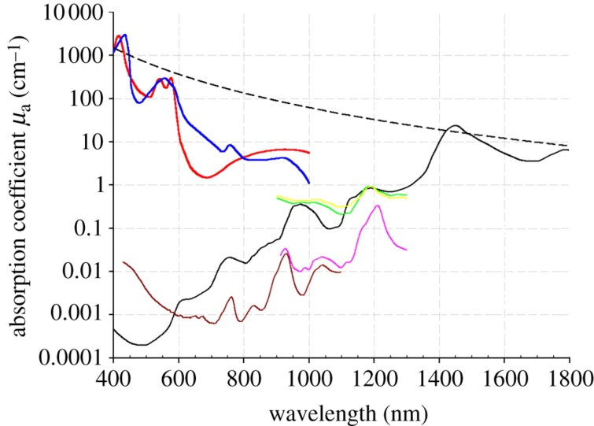
Photoacoustic Imaging: Spectral Properties
Oxyhemoglobin
Deoxyhemoglobin
Elastin
Collagen
Lipid (a) (b)
Water
(from Beard, 2011)
different wavelengths allow quantitative spectroscopic examinations
gap between oxygenated and deoxygenated blood
use of contrast agents for molecular imaging

Slide 8
Ultrasound Tomography (UST)
sound in, sound out
different from conventional US but as safe
quantitative images of acoustic properties
novel diagnostic information
adapted from Rianne Bulthuis and Maura Dantuma

Slide 9
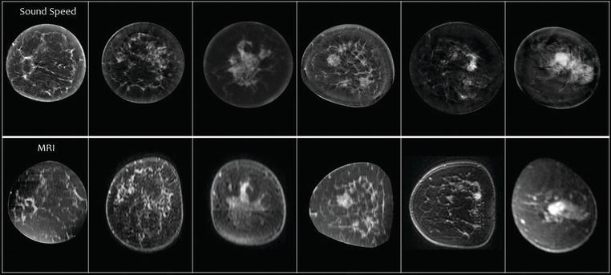
Speed of Sound vs MRI Images
From: Duric, Littrup, 2017. Breast Ultrasound Tomography, IntechOpen

Slide 10
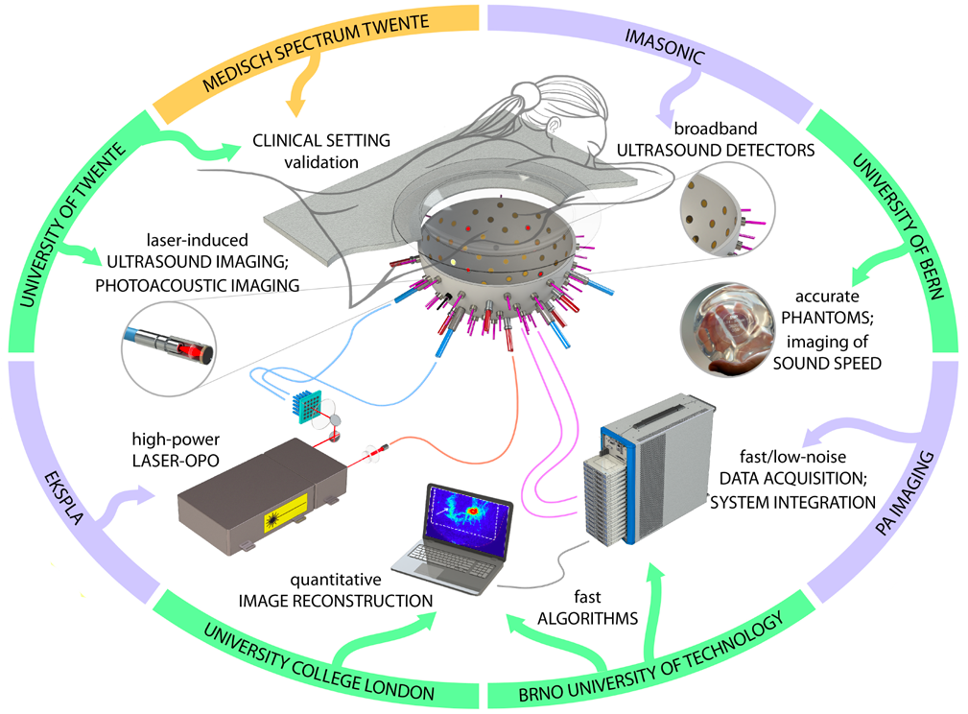
H2020: PAMMOTH
Combined PAT+UST scanner to obtain novel diagnostic information from high resolution maps of optical and acoustic properties

Slide 11

PAM3 System

Slide 12
Our Contributions
simulation studies for
ultrasonic transducer specification
light excitation design
sensing pattern design
measurement protocol design
reconstruction algorithm design
accuracy vs. computational time/resources/complexity
scanner modelling
assist high performance computing implementation
assist phantom & calibration design
process data, refine measurement procedures

Slide 13
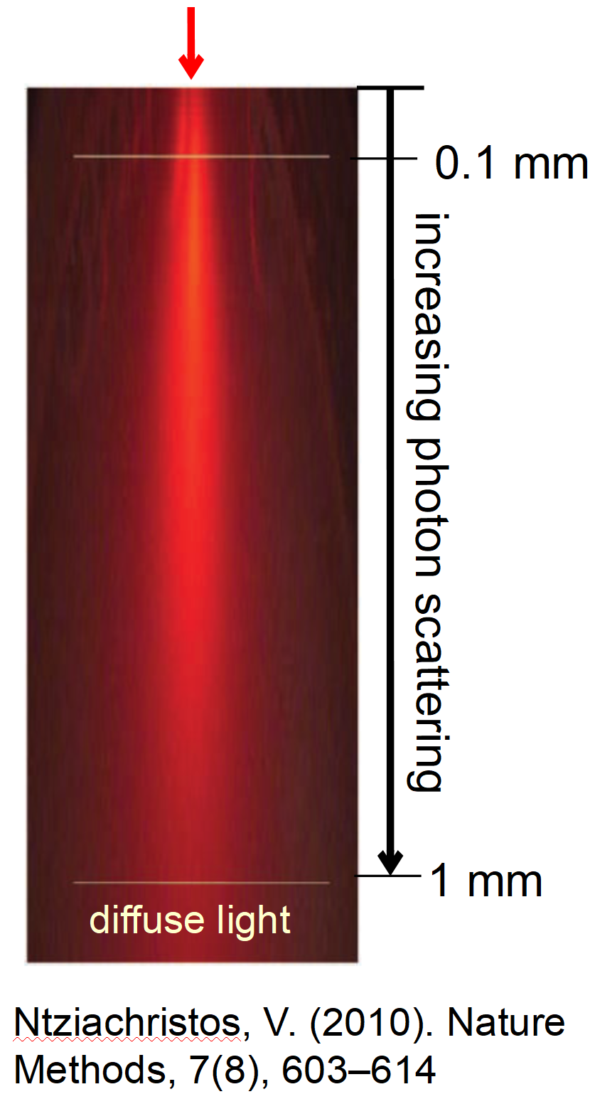
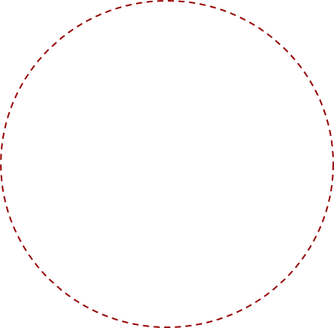









PAT: Mathematical Modelling
radiative transfer equation (RTE)
photoacoustic effect
acoustic wave equation
measurement (on boundary)
two coupled inverse problems:
acoustic initial value problem with boundary data.
optical parameter identification with internal data.
$$(v⋅∇\text{ +}μ_{a}\left(x\right)+μ_{s}\left(x\right)\text{) }ϕ\left(x,v\right)=q\left(x,v\right)+μ_{s}\left(x\right)∫Θ\left(v,v^{′}\right) ϕ\left(x,v^{′}\right)dv′$$
$$p_{0}(x)=Γ\left(x\right)μ_{a}\left(x\right)∫ϕ\left(x,v^{′}\right)dv′$$
$$\left(c{\left(x\right)}^{−2} ∂_{t}^{2}−Δ\right) p\left(x, t\right)=0, p\left(x,0\right)=p_{0}\left(x\right), ∂_{t}p\left(x,0\right)=0$$
$$f= Mp$$
$$f→p_{0}$$
$$p_{0}→μ_{a}$$

Slide 14



Reconstruction of Initial Photoacoustic Pressure
$$\left(c{\left(x\right)}^{−2} ∂_{t}^{2}−Δ\right) p\left(x, t\right)=0, p\left(x,0\right)=p_{0}\left(x\right), f= Mp$$
$$f= MAp_{0}$$
$${\hat{p}}_{0}=\underset{p_{0}∈C}{argmin}{ {\left\|MAp_{0}−f\right\|}_{W}^{2}+R\left(p_{0}\right)}$$
linear inverse problem
variational approach
first order optimization with early stopping
model acoustic properties, model discrepancies
model /calibrate piezoelectric sensor properties: sensitivity, impulse response, angular sensitivity, …
parameter choices, image artifacts, …
high res (0.4mm), broadband numerical wave simulations

Slide 15
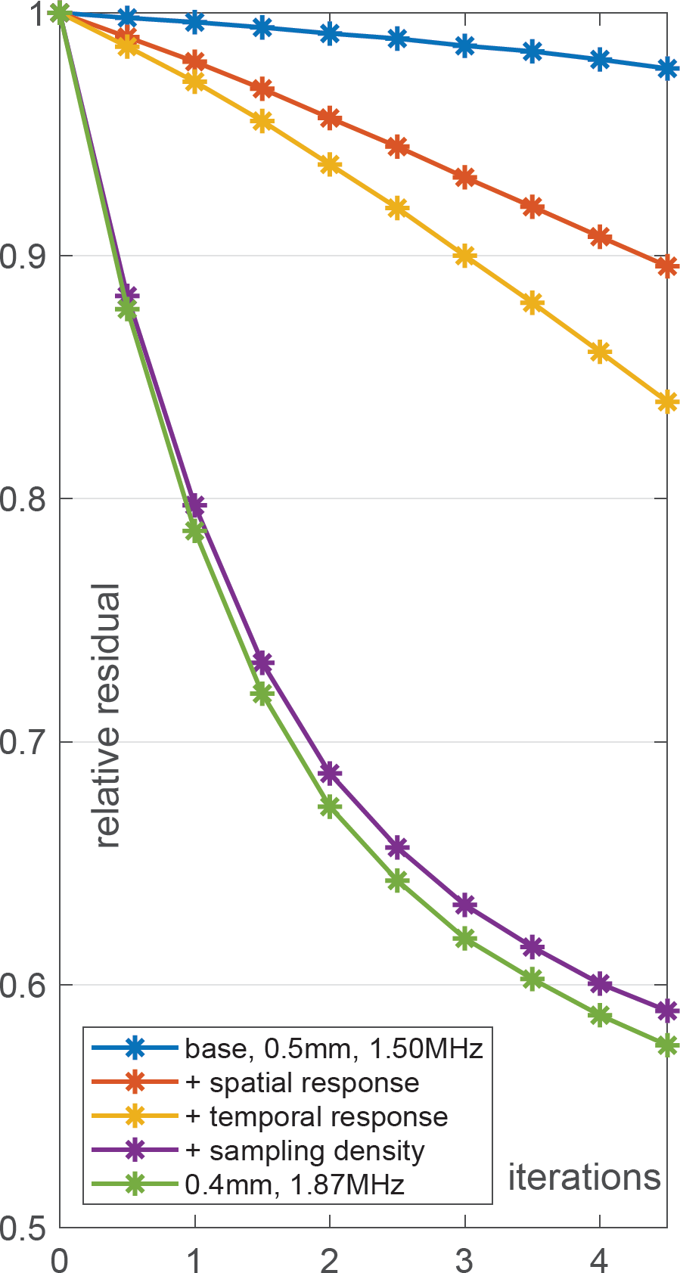
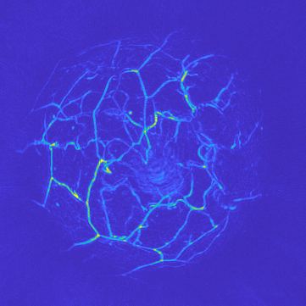
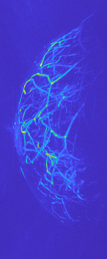
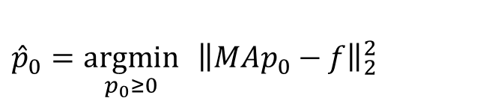
PAT Modeling, baseline
$${\hat{p}}_{0}=\underset{p_{0}≥0}{argmin}{ {\left\|MAp_{0}−f\right\|}_{2}^{2}}$$
Notes:
SOS model: cup

Slide 16
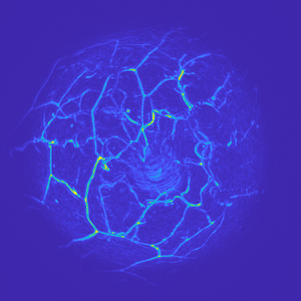
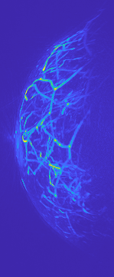
PAT Modeling, + spatial response
$${\hat{p}}_{0}=\underset{p_{0}≥0}{argmin}{ {\left\|MAp_{0}−f\right\|}_{2}^{2}}$$
Notes:
SOS model: cup

Slide 17
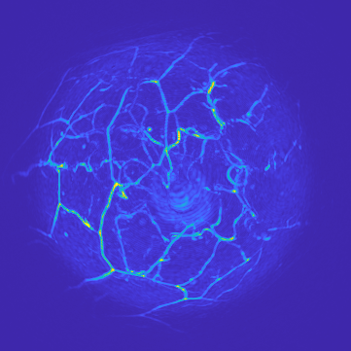
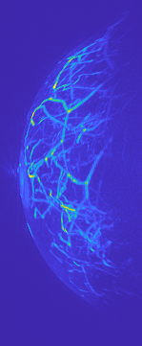
PAT Modeling, + temporal response
$${\hat{p}}_{0}=\underset{p_{0}≥0}{argmin}{ {\left\|MAp_{0}−f\right\|}_{2}^{2}}$$
Notes:
SOS model: cup

Slide 18
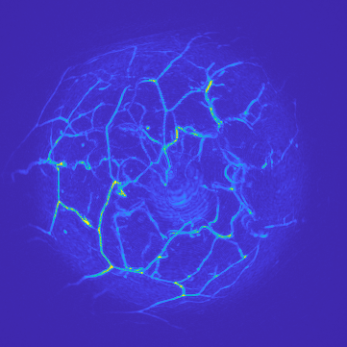
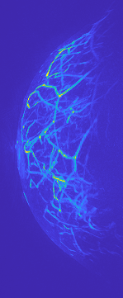
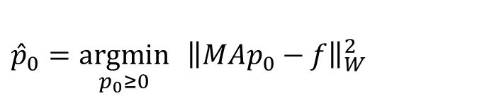
PAT Modeling, + sampling density
$${\hat{p}}_{0}=\underset{p_{0}≥0}{argmin}{ {\left\|MAp_{0}−f\right\|}_{W}^{2}}$$
Notes:
SOS model: cup

Slide 19
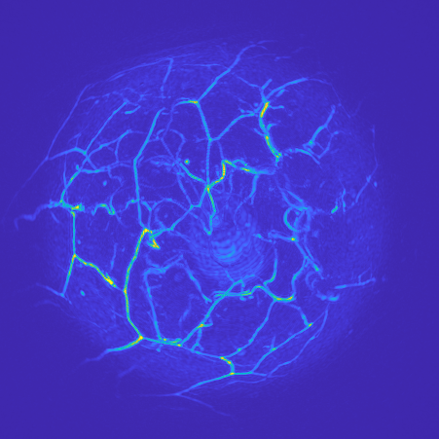

PAT Modeling, higher resolution
$${\hat{p}}_{0}=\underset{p_{0}≥0}{argmin}{ {\left\|MAp_{0}−f\right\|}_{W}^{2}}$$
Notes:
SOS model: cup

Slide 20
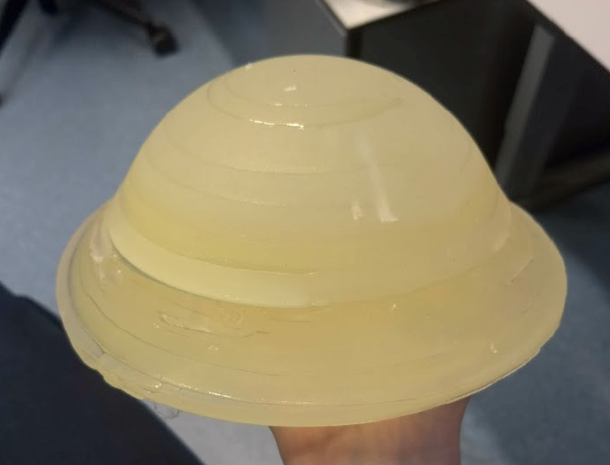
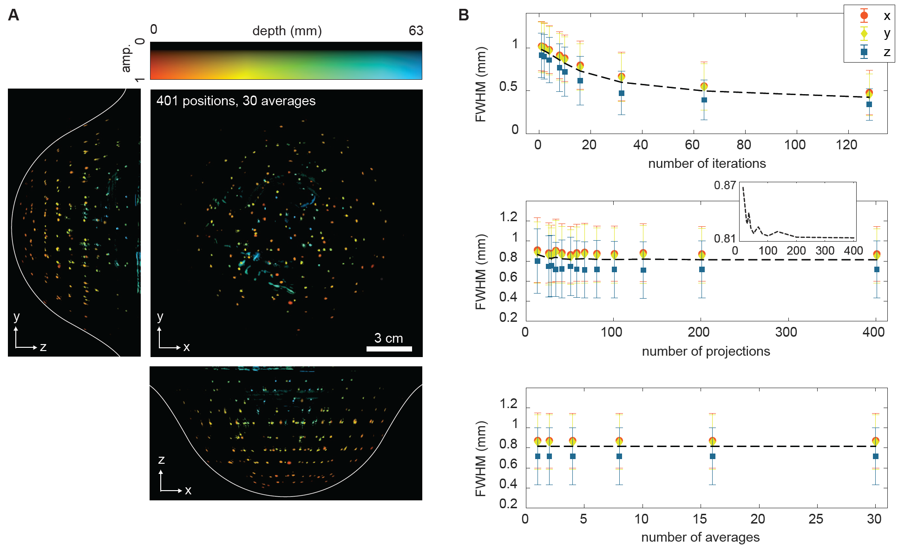
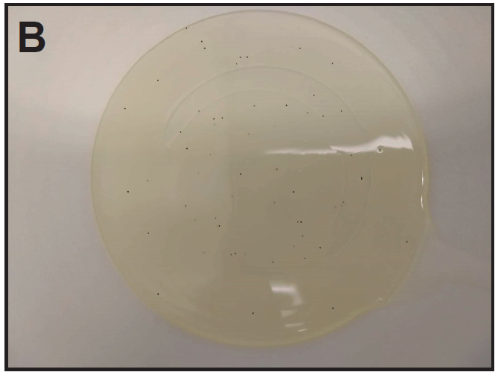
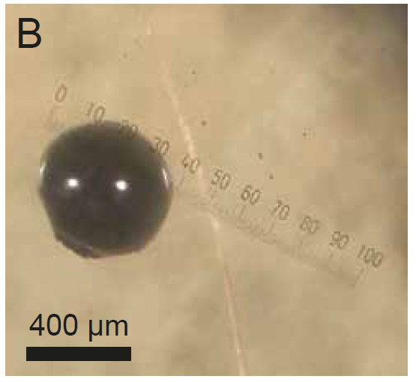
Illustration: Phantom Validation

Slide 21
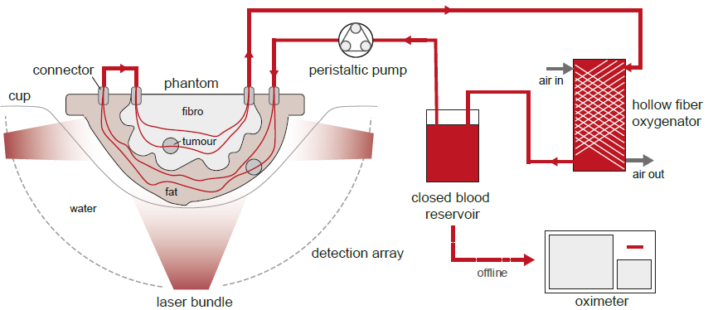
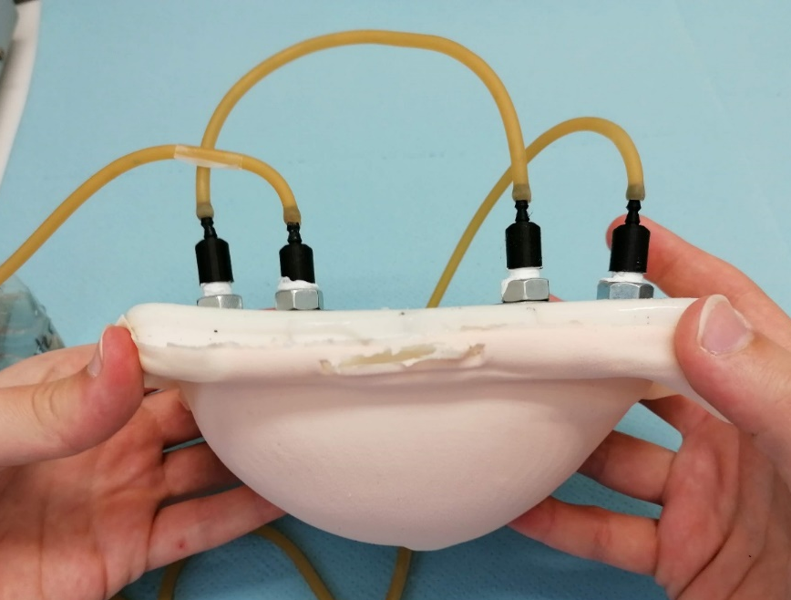
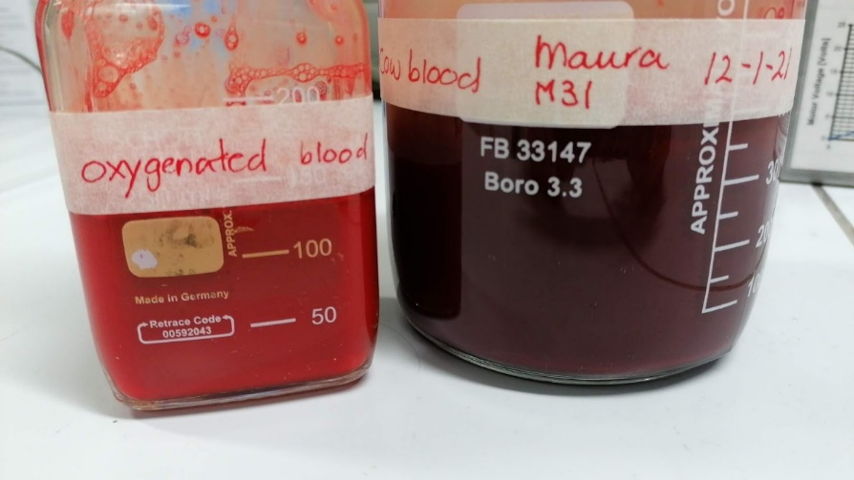
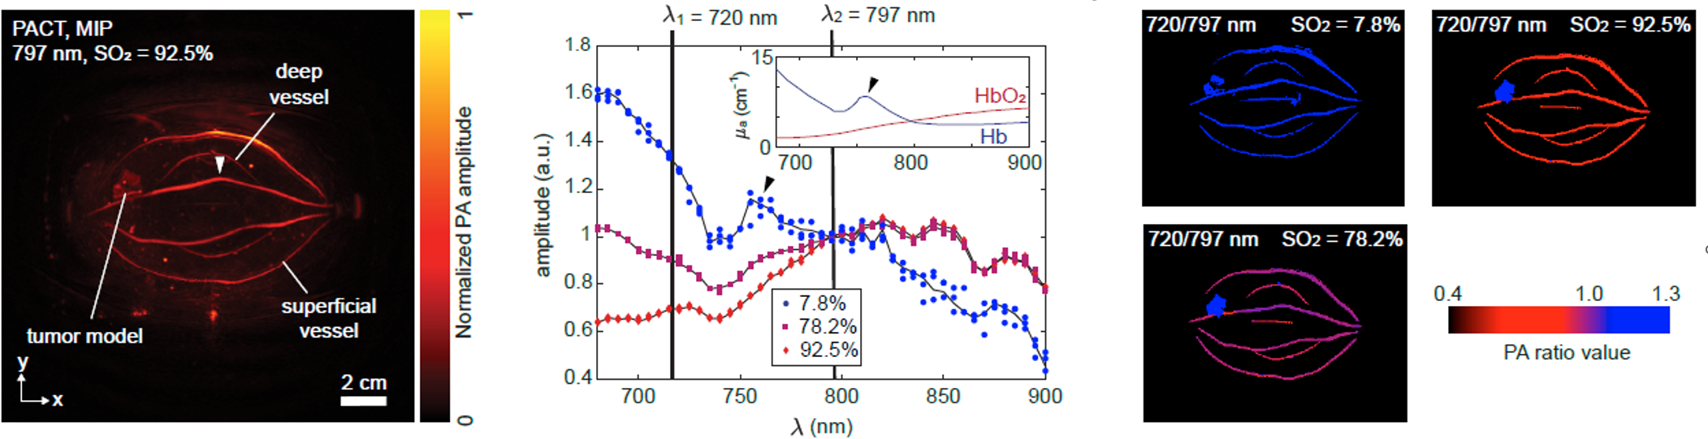
Illustration: Phantom Validation

Slide 22
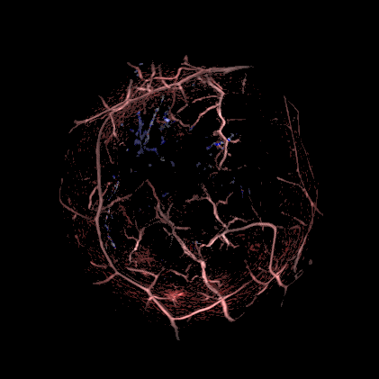

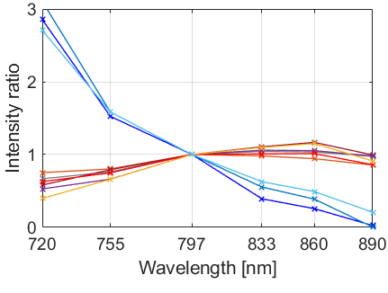
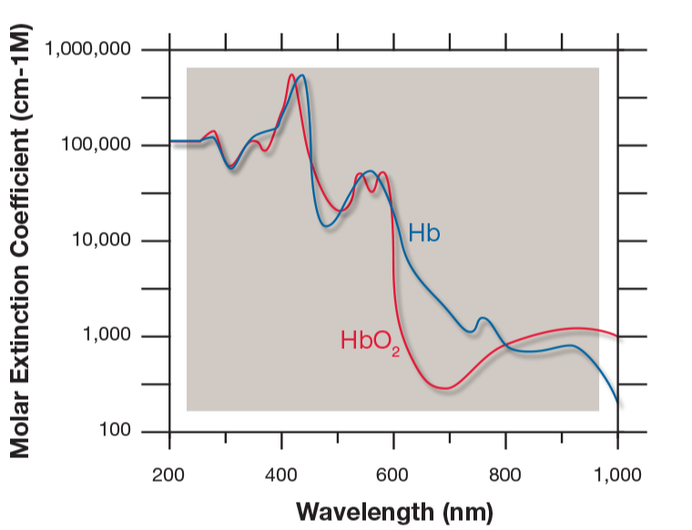
Illustration: In Vivo Results
>1
Intensity ratio 890 nm / 720 nm
<1
Figure from: Spectrum Medical, Non-Invasive Measurement of SaO₂, SvO₂ & Hemoglobin

Slide 23
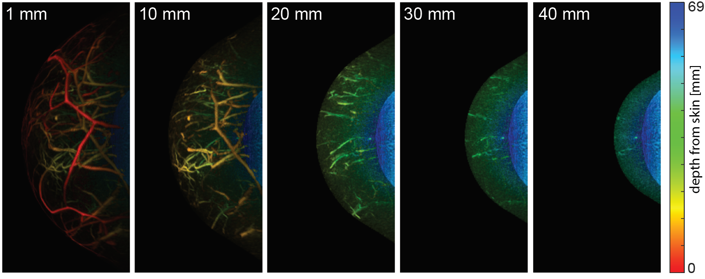
How deep can we image?
medial-lateral depth color-coded PAT MIPs
48 mm
Increasing depth from skin

Slide 24




UST: Mathematical Modelling (simplified)
acoustic wave equation
measurement (on boundary)
multiple sources
inverse problem:
acoustic parameter identification problem with boundary data.
$$\left(c{\left(x\right)}^{−2} ∂_{t}^{2}−Δ\right) p_{i}\left(x, t\right)=s_{i}\left(x,t\right)$$
$$f_{i}= M_{i}p_{i}$$
$$i=1, …, N_{s}$$
$$f→c$$

Slide 25

UST Reconstruction Approaches
Travel time tomography: geometrical optics approximation
robust & computationally efficient (time-of-flight picking followed by linear inversion)
valid for high frequencies (attenuation!), low res, lots of data
Javaherian, L, Cox, 2020. Refraction-corrected ray-based inversion for three-dimensional ultrasound tomography of the breast. Inverse Problems
Full waveform inversion (FWI): fit full wave model to all data
high res from little data, transducer modelling, constraints
many wave simulations, complex numerical optimization
lower TRL but already used in 2D systems
our system is not designed for it

Slide 26
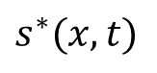


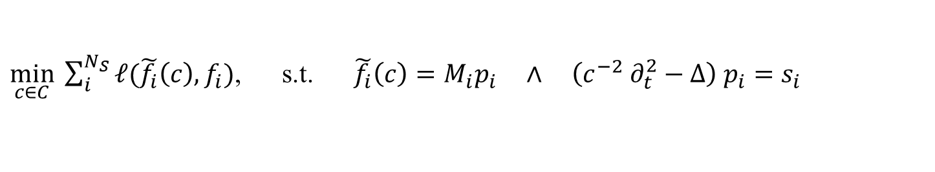
Time Domain Full Waveform Inversion
$\min_{c∈C}{\sum_{i}^{N_{S}}{ℓ(\tilde{f_{i}}\left(c\right), f_{i})}}$, s.t. $\tilde{f_{i}}\left(c\right)=M_{i}p_{i} ∧ \left(c^{−2} ∂_{t}^{2}−Δ\right) p_{i}=s_{i}$
gradient for first-order optimization via adjoint state method
where is the time-reversed data discrepancy
two wave simulations for one gradient (for one source ☹)
Starting point in 2D:
$$∇_{c}ℓ\left(\tilde{f}\left(c\right), f\right)\text{= }\text{2 }\int_{0}^{T}{{c\left(x\right)}^{−3} ∂_{t}^{2}p\left(x,t\right) q^{∗}\left(x, t\right) dt, }$$
$$\left(c^{−2} ∂_{t}^{2}−Δ\right) q^{∗}=s^{∗},$$
$$s^{∗}(x,t)$$
Pérez-Liva, Herraiz, Udías, Miller, Cox, Treeby, 2017. Time domain reconstruction of sound speed and attenuation in ultrasound computed tomography using full wave inversion. JASA

Slide 27
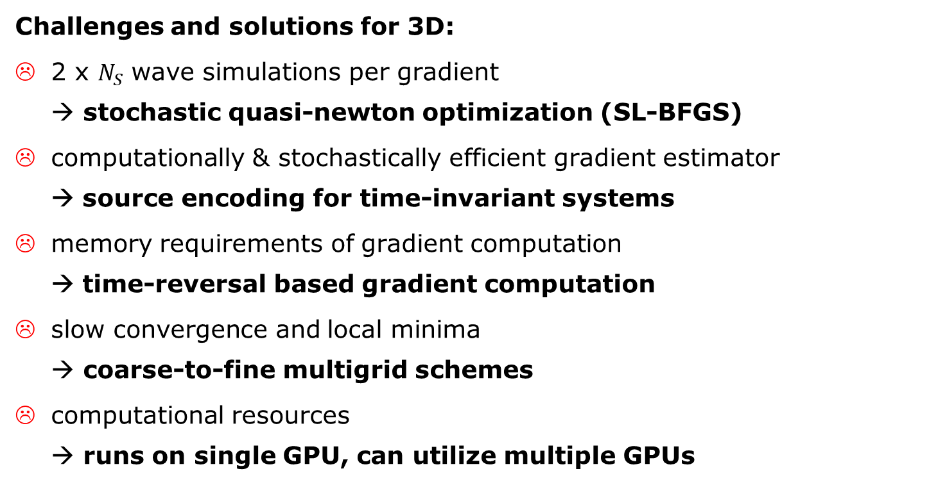

3D Time Domain FWI for Breast UST
$\min_{c∈C}{\sum_{i}^{N_{S}}{ℓ(\tilde{f_{i}}\left(c\right), f_{i})}}$, $∇_{c}ℓ\left(\tilde{f}\left(c\right), f\right)\text{= }\text{2 }\int_{0}^{T}{{c\left(x\right)}^{−3} ∂_{t}^{2}p\left(x,t\right) q^{∗}\left(x, t\right) dt}$
Challenges and solutions for 3D:
2 x $N_{S}$ wave simulations per gradient → stochastic quasi-newton optimization (SL-BFGS)
computationally & stochastically efficient gradient estimator → source encoding for time-invariant systems
memory requirements of gradient computation → time-reversal based gradient computation
slow convergence and local minima → coarse-to-fine multigrid schemes
computational resources → runs on single GPU, can utilize multiple GPUs

Slide 28



Numerical proof-of-concept study
L, Pérez-Liva, Treeby, Cox, 2021. High Resolution 3D Ultrasonic Breast Imaging by Time-Domain Full Waveform Inversion. Inverse Problems

Slide 29




Numerical proof-of-concept study
Starting point
Improvement
L, Pérez-Liva, Treeby, Cox, 2021. High Resolution 3D Ultrasonic Breast Imaging by Time-Domain Full Waveform Inversion. Inverse Problems

Slide 30
FWI for Experimental Data: Where Are We?
data from phantom objects, volunteers & patients
ray-based travel time tomography reconstructions
photoacoustic reconstructions → data pre-processing, scanner & transducer modelling, wave simulations
modeling of US protocol, data read-in & pre-processing
model calibration
FWI of phantom objects, quantitative evaluation
FWI of volunteer / patient data
Clinical evaluation

Slide 31







SOS Phantom
X
Z
SOS – c_{water}
Y
-100 0 +100
Notes:
50.000 source activations

Slide 32



SOS Phantom: Travel Time Tomography
X
Z
X
Z
SOS – c_{water}
SOS – c_{water}
Y
Y
Y
2.0mm grid; (bent-ray)
-100 0 +100

Slide 33



SOS Phantom: FWI
X
Z
X
Z
SOS – c_{water}
SOS – c_{water}
Y
Y
Y
2.0 mm grid, 0.37/0.21 MHz, 0.22% original signal
-100 0 +100

Slide 34



SOS Phantom: FWI
X
Z
X
Z
SOS – c_{water}
SOS – c_{water}
Y
Y
Y
1.5 mm grid, 0.50/0.28 MHz, 0.52% original signal
-100 0 +100

Slide 35



SOS Phantom: FWI
X
Z
X
Z
SOS – c_{water}
SOS – c_{water}
Y
Y
Y
1.0 mm grid, 0.75/0.42 MHz, 2.47% original signal
-100 0 +100

Slide 36



SOS Phantom: FWI
X
Z
X
Z
SOS – c_{water}
SOS – c_{water}
Y
Y
Y
0.8 mm grid, 0.94/0.53 MHz, 6.55% original signal
-100 0 +100

Slide 37



In Vivo Results: TTT
X
Z
SOS – c_{water}
2.0mm grid
bent ray
Y
-100 0 +100

Slide 38



In Vivo Results FWI
X
Z
SOS – c_{water}
2.0mm grid
0.22% original signal
Y
-100 0 +100

Slide 39



In Vivo Results FWI
X
Z
SOS – c_{water}
1.5mm grid
0.52% original signal
Y
-100 0 +100

Slide 40



In Vivo Results FWI
X
Z
SOS – c_{water}
1.0mm grid
2.47% original signal
Y
-100 0 +100

Slide 41



In Vivo Results FWI
X
Z
SOS – c_{water}
0.8mm grid
6.55% original signal
Y
-100 0 +100

Slide 42



In Vivo Results FWI
X
Z
SOS – c_{water}
0.6mm grid
21.35% original signal
Y
-100 0 +100

Slide 43






Improvement (up to now…)
X
Z
X
Z
SOS – c_{water}
SOS – c_{water}
Y
Y
Y
-100 0 +100

Slide 44
Improvement (up to now…)
X
Z
X
Z
SOS – c_{water}
SOS – c_{water}
Y
Y
Y
-100 0 +100

Slide 45





Summary & Outlook
need for novel breast imaging techniques
photoacoustic (PAT) and ultrasound tomography (UST) give access to high-quality images of optical and acoustic tissue properties
combined PAT+UST scanner designed & build
evaluation on data from phantoms, volunteers & patients
PAT reconstructions work well
proof-of-concept studies of FWI for high resolution 3D UST
demonstration of FWI on experimental data
optical inversion in PAT (QPAT)
Dantuma et al., 2023. Fully three-dimensional sound speed-corrected multi-wavelength photoacoustic breast tomography. submitted
L, Pérez-Liva, Treeby, Cox, 2021. High Resolution 3D Ultrasonic Breast Imaging by Time-Domain Full Waveform Inversion. Inverse Problems
Felix.Lucka@cwi.nl Photoacoustic and Ultrasonic Tomography for Breast Imaging

Slide 46
Acoustic Wave Solvers
Direct methods
finite-difference
pseudospectral
finite/spectral element
discontinous Galerkin
Integral equation methods
boundary element
Asymptotic methods
geometrical optics
Gaussian beams
Time domain vs. frequency domain

Slide 47
k-Wave
Time-domain k-space pseudospectral method solving the underlying system of first order conservation laws
compute spatial derivatives via 3D FFTs
parallel/GPU computing
modify finite temporal differences by k-space operator + staggered grids for accuracy and robustness
perfectly matched layer → free-space propagation
Treeby, Cox, 2010. k-Wave: MATLAB toolbox for the simulation and reconstruction of photoacoustic wave fields. Journal of Biomedical Optics

Slide 48





SOS phantom, gradient illustrations
X
Z
X
Z
SOS – c_{water}
- grad est
(512 avg)
Y
Y
Y
1mm grid, 2.5% of original signal
-100 0 +100
Notes:
full data, 1mm, 512 averages SE, water. Uses 2.5% of the energy of the original data (from 25MHz to 0.42MHz)

Slide 49



SOS phantom, gradient illustrations
X
Z
X
Z
GT - SOS
- grad est
(512 avg)
Y
Y
Y
1mm grid, 2.5% of original signal
-100 0 +100
Notes:
full data, 1mm, 512 averages SE, water

Slide 50






SOS phantom, gradient illustrations
X
Z
X
Z
SOS – c_{water}
- grad est
(512 avg)
Y
Y
Y
1mm grid, 2.5% of original signal
-100 0 +100
Notes:
full data, 1mm, 512 averages SE, cup with 1459 m/s

Slide 51



SOS phantom, gradient illustrations
X
Z
X
Z
GT - SOS
- grad est
(512 avg)
Y
Y
Y
1mm grid, 2.5% of original signal
-100 0 +100
Notes:
full data, 1mm, 512 averages SE, cup with 1459 m/s

Slide 52






SOS phantom, gradient illustrations
X
Z
X
Z
SOS – c_{water}
- grad est
(512 avg)
Y
Y
Y
1mm grid, 2.5% of original signal
-100 0 +100
Notes:
full data, 1mm, 512 averages SE, 3sos, 1459 / 1514 m/s

Slide 53



SOS phantom, gradient illustrations
X
Z
X
Z
GT - SOS
- grad est
(512 avg)
Y
Y
Y
1mm grid, 2.5% of original signal
-100 0 +100
Notes:
full data, 1mm, 512 averages SE, 3sos, 1459 / 1514 m/s

Slide 54






SOS phantom, gradient illustrations
X
Z
X
Z
SOS – c_{water}
- grad est
(512 avg)
Y
Y
Y
1mm grid, 2.5% of original signal
-100 0 +100
Notes:
full data, 1mm, 512 averages SE, TOF

Slide 55



SOS phantom, gradient illustrations
X
Z
X
Z
GT - SOS
- grad est
(512 avg)
Y
Y
Y
-100 0 +100
Notes:
full data, 1mm, 512 averages SE, 3sos, 1459 / 1514 m/s

